Slide 1
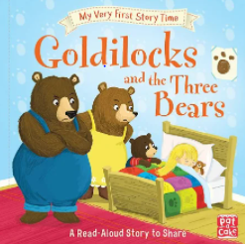
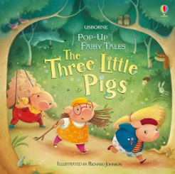
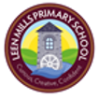
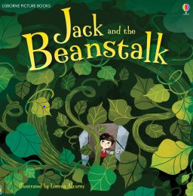
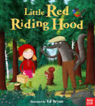
Into the Woods
Traditional Tales
Enquiry Questions
Spring 2
Key Books
Goldilocks and the Three Bears
The Three Little Pigs
Red Riding Hood
Jack and the Beanstalk
Is Goldilocks a bad character?
What would you build your house out of?
What would be at the top of your beanstalk?
Key Vocabulary
Once upon a time, one day, then, they lived happily ever after, the end, first, next, after that, finally, small, medium, large, bricks, sticks, straw, beanstalk, castle, giant, porridge, wolf,
Traditional Tale
A folk tale which has been passed down for many generations.

