Slide 1
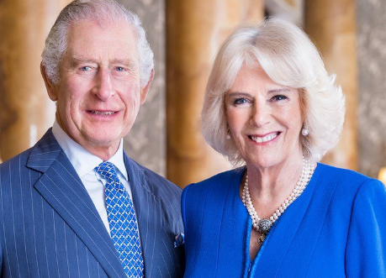
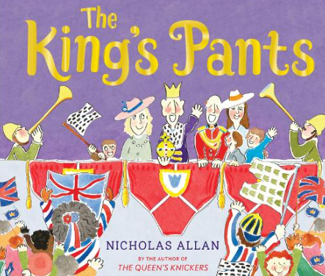
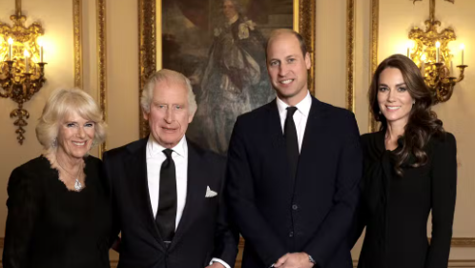
King Charles III
The King’s Coronation
Enquiry Questions
Summer 1 2023
Key Book
The King’s Pants by Nicholas Allan
Who is the King?
What does the King do?
What is a Coronation and why is it important?
Key Vocabulary
King, Queen, Prince, Princess, Buckingham Palace, Royal family, Westminster Abbey, London, crown, sovereign, monarch, duty, United Kingdom, Commonwealth, heir, throne
Coronation
The ceremony of crowning a sovereign.

