Slide 1
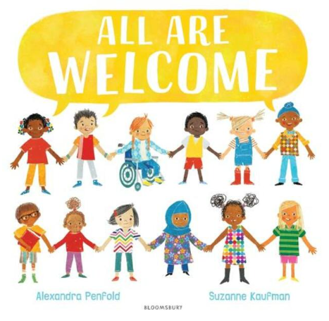
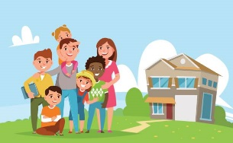
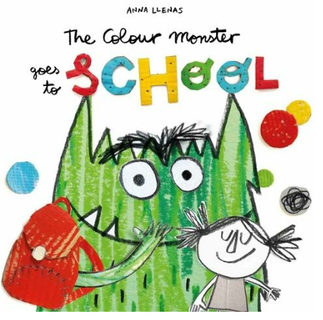
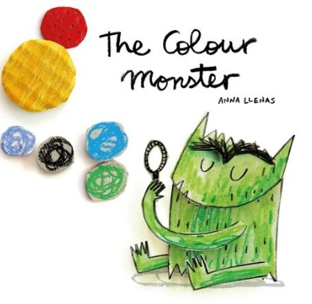
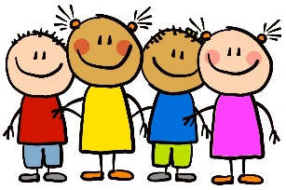
Marvellous Me!
Enquiry Questions
Autumn 1
2022
Key Texts
All Are Welcome by Alexandra Penfold
The Colour Monster by Anna Llenas
The Colour Monster goes to school by Anna Llenas
Who is in my family?
How are we the same and how are we unique?
All about me
My family
What happens at school?
Key Vocabulary
Family, home, school, classroom, playground, new, same, unique, feelings, happiness, fear, calm, scared, excited
Who are my new friends?
My new school
Who are my teachers?
My new friends
Family
Families can look very different from each other, but all family members usually love and care for each other very much.

